Slide 1
Predicting Umpire Error in Baseball
John Russell
Liam Taylor
Radvilas Pelanis
Roshen Chatwal
CS109a Final Project
Notes:
Each pitch in a baseball game has the potential to change game outcomes, so incorrect calls by umpires carry a lot of weight.
Because of this, catchers and pitchers will try to frame pitches so the call goes their way. Additionally, other factors like pressure when there’s 2 strikes or 3 balls, or specifics on the pitch itself, might also influence the umpire’s ability to call pitches. By combining umpire scorecards data that tracks incorrect calls, with game and player data from statcast and other sources, we were able to do some research.

Slide 2
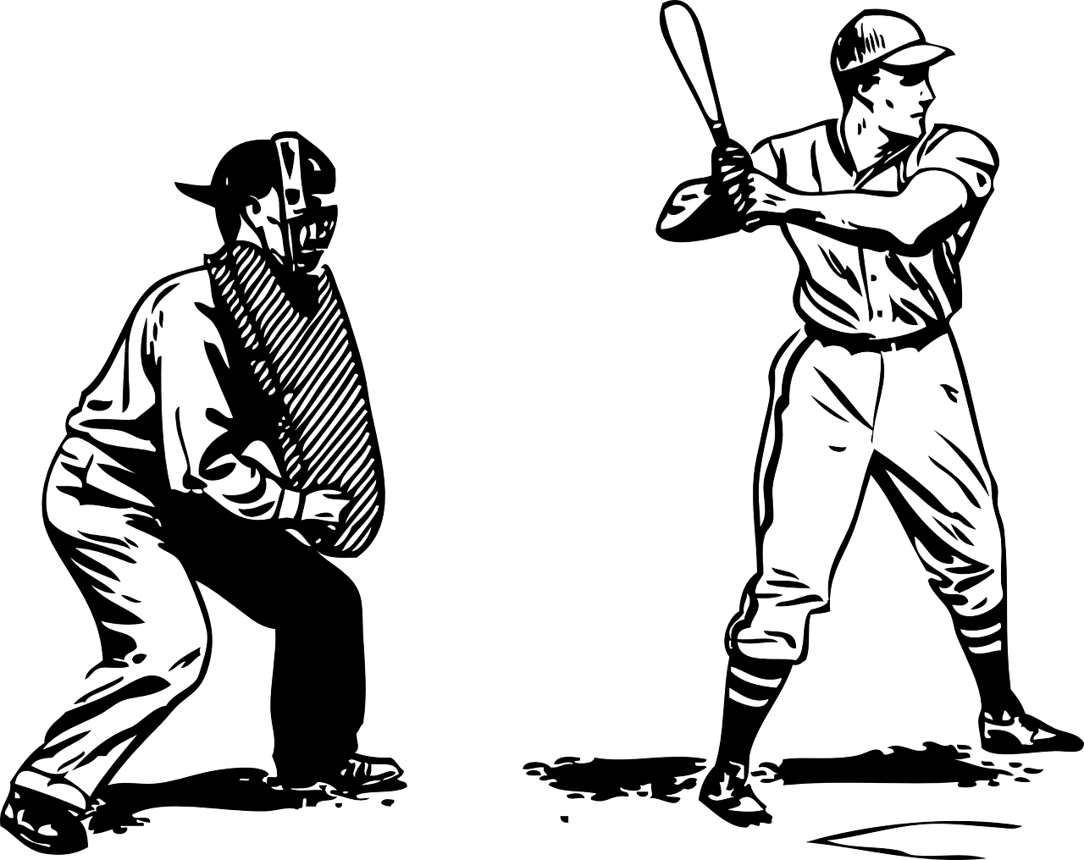
In this project, we attempt to determine the association of various factors (regarding the pitcher, catcher, and umpire) with umpire bias, and to develop a regression model which can predict the score impact of incorrect calls in a game based on the pitching, catching, and umpiring metrics from the game.
Based on past pitcher, catcher, and umpire data, can we effectively predict the projected impact of umpire error and pitch-framing in game outcomes?
Which factors have the biggest effect on umpire calls?
Problem Statement
Research Questions
Notes:
rosh

Slide 3
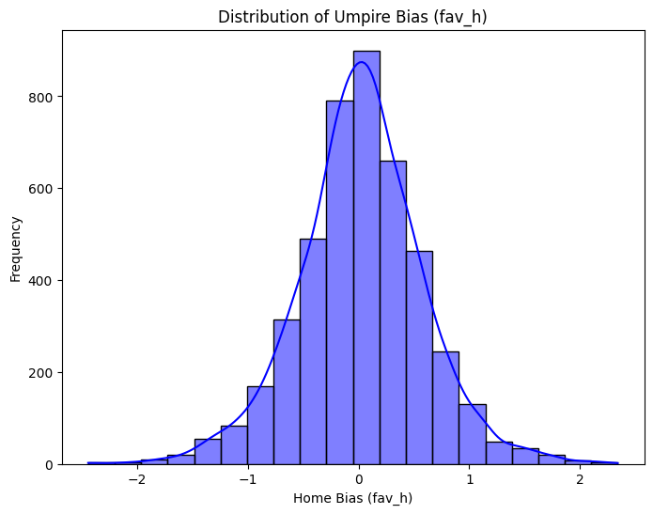
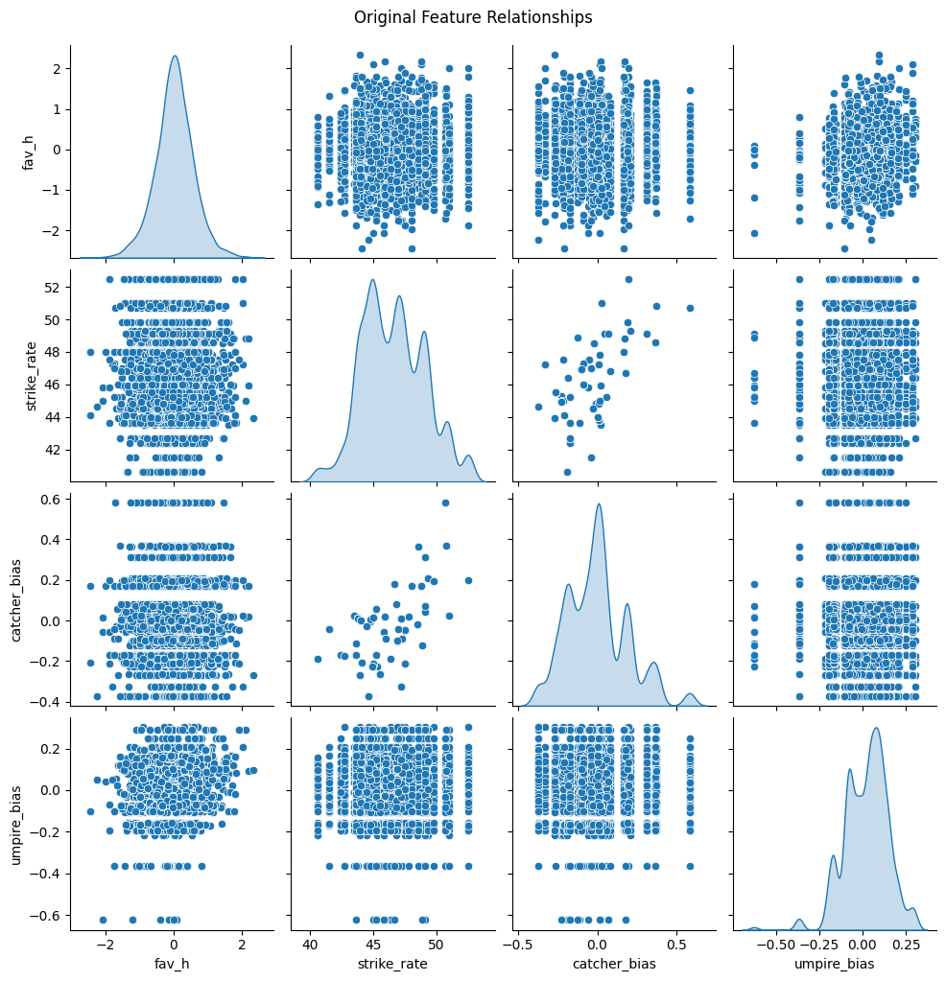
Exploratory Data Analysis (1)
Notes:
rosh
LEFT GRAPH:
Description: the graph shows the distribution of umpire bias towards home team across all games in 2024 MLB season.
Interpretation: the distribution seems evenly and symmetrically distributed with both mean and median centered around 0.
RIGHT GRAPH:
Description: histogram and scatter graphs represent relationships between most important features, including umpire bias, strike rate, catcher bias, umpire bias towards home team.
Interpretation: while some graphs do not show clear trends, other ones (e.g. catcher_bias vs. strike_rate) show potential signs of correlation.

Slide 4
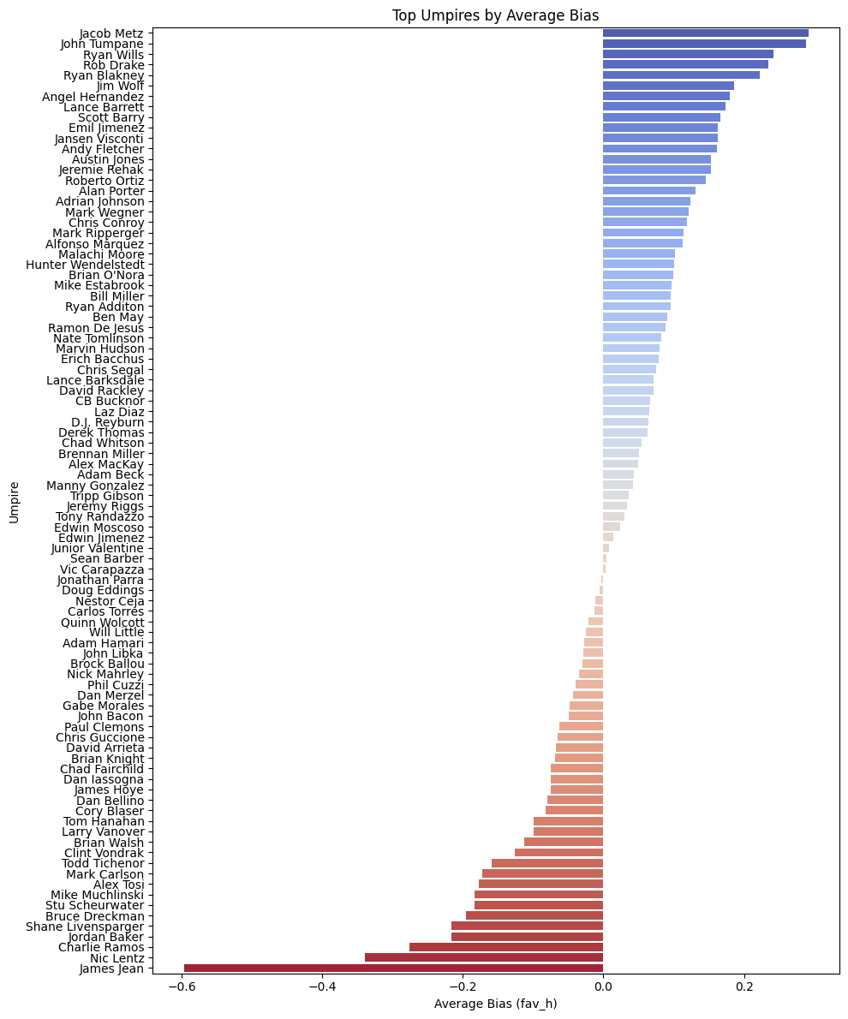
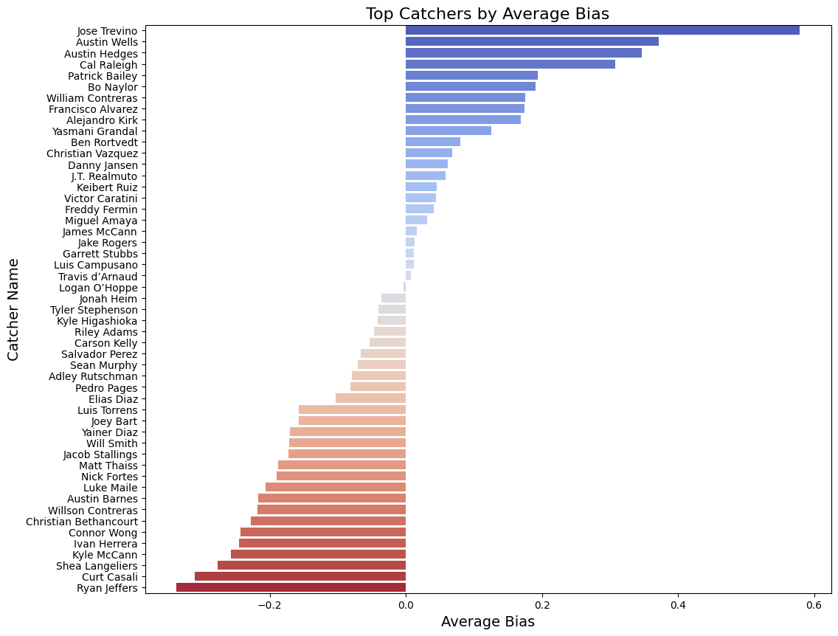
Exploratory Data Analysis (2)
Notes:
rosh
LEFT GRAPH:
Description: the graph identifies the umpires that had the highest versus lowest biases.
Interpretation: there is a wide range of umpires with extreme average biases, however, most can be encompassed within the range (-0.2, 0.3) of average bias.
RIGHT GRAPH:
Description: the graph identifies the catchers that encountered the highest versus lowest biases from the umpires.
Interpretation: the range of biases encountered is not as wide as in EDA (3), and most of it can be encompassed within range (-0.1, 0.15).

Slide 5
Final Model Pipeline
Our predictor variables are the following: 'catcher_bias', 'umpire_bias', 'interaction_home_umpire', 'strike_rate', 'stand_L' , 'stand_R', 'p_throws_L', 'p_throws_R'.
Our target variable: 'fav_h'.
We engineer polynomial features by setting degree equal to 2, implementing a StandardScaler, and defining our test_train_split such that our test size is 0.3, and random state is 42.

Slide 6
Baseline Model
Goal: to predict the average target value (fav_h) for all games. This will serve as a benchmark to understand if engineering features and more advanced models can improve predictive accuracy in the first place.
We use MSE and R² to measure baseline performance:
test_MSE = 0.3501.
train_MSE = 0.3034.
R^2 = -0.0007.
Notes:
A naive baseline model would be to predict the average target value (fav_h) for all games. This will serce as a benchmark to understand if engineering features and more advanced models can improve predictive accuracy in the first place. We use MSE to measure baseline performance.
The baseline model assumes:
No relationship b/w the predictors and the target.
All predictions are equal to the mean of fav_h.
Any model that outperforms this naive prediction should be considered valuable.

Slide 7
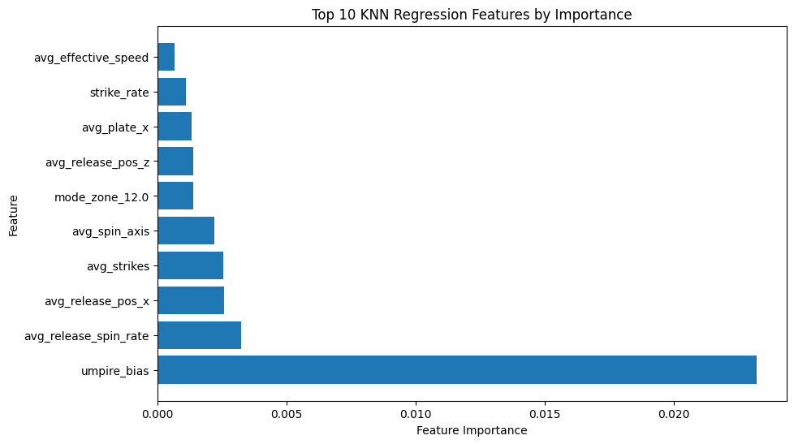
Model: kNN Regression with CV
For kNN regression, we test K values from 1 to 80, with K=67 identified as optimal.
At such model, we obtain:
train_MSE=0.2861
test_MSE=0.3451
Both of which show improvement compared to baseline model.
Training Time (with CV): < 1 min
Notes:
kNN Regression is a non-parametric regression technique that may be helpful in modeling non-linear relationships between predictors and our response variable fav_h. A higher value of k will lead to higher model complexity, and this can be tuned via cross-validatoin.
Because of this, we expect it to outperform the naive model, and perhaps our simplest decision tree model, but we do not expect it to do as well as our more thorough methods like Random Forest, Bagging, or Boosting.
Applying Permutation Importance identifies importances of every single feature used to predict the target variable. Listing the kNN features by importance shows that umpire_bias is a dominating feature while other ones such as interaction_home_umpire, avg_plate_x might also have some impact over kNN Regression results.

Slide 8
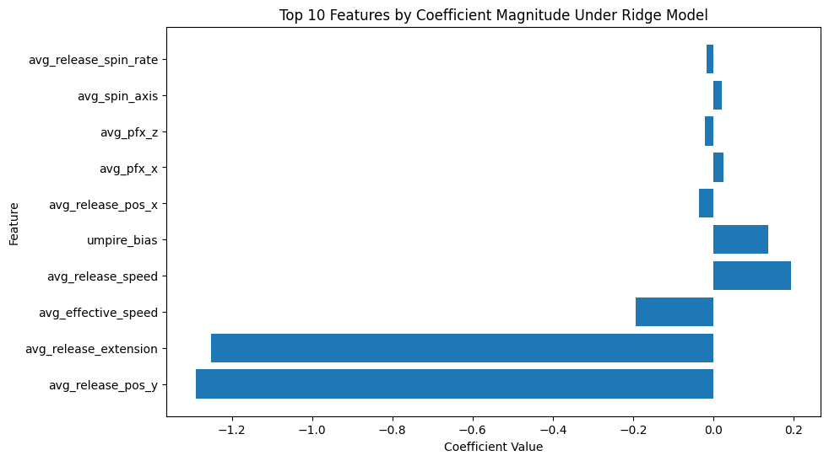
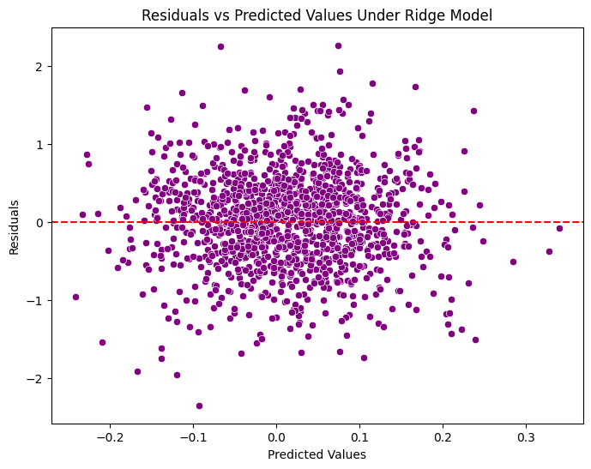
Model: Ridge with CV
The Ridge regression cross-validation identified an optimal alpha of 0.01, minimizing mean cross-validated MSE. The train MSE is 0.2825, while test MSE is 0.3406, both an improvement compared to kNN Regression. However, the low R² value (0.0256) suggests the model explains very little variance in the test data.
Training Time (with CV): < 1 min
Notes:
Linear regression will assume a linear relationship between our predictors and response. This model will perform well if that assumption is correct, but will not do as well if the relationship is more complicated and nonlinear (which is likely for at least some predictors). Ridge regularization will help prevent overfitting by shrinking coefficients and optimizing the bias-variance tradeoff.
Given that a linear approximation may not be the ideal relationship between our features and bias, we expect linear regression with ridge regularization to improve upon the baseline model, but be less accurate than non-parametric or ensemble methods like kNN and Random Forest.
Release position and extension for pitching appear the most important here, a departure from other models.
Residual Analysis: Showing that there's a fairly constant variance across residuals (homoskedacisity) supports our assumption of a linear relationship because

Slide 9
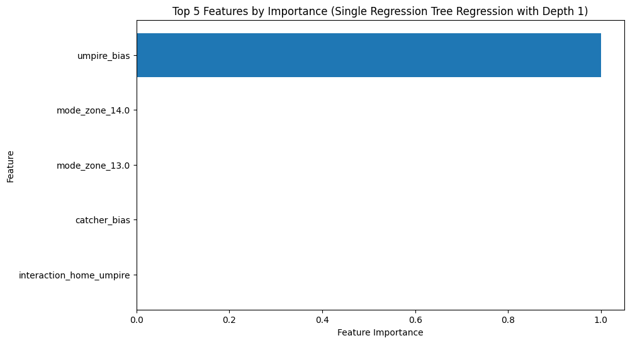
Model: Regression Decision Tree
We run the model for max_depth from 1 to 9, identifying the optimal depth = 1. Train MSE = 0.2887, Test MSE = 0.3527, Test R² = -0.008, identifying a better performance in train but not test datasets compared to Ridge Regression.
Training Time (with CV): < 1 min
Notes:
A single regression decision tree is a simple model that will likely be unable to capture the complexities of our data. We learned several methods such as RF, Bagging, and Boosting to combine trees for better results, so we expect those ensemble learning methods to do much better compared to a single tree.
Umpire bias appears the most important feature by far. Notice that fewer features can be used in a single tree.
Note that there's at maximum 5 features usable in a simple tree with max_depth 3

Slide 10
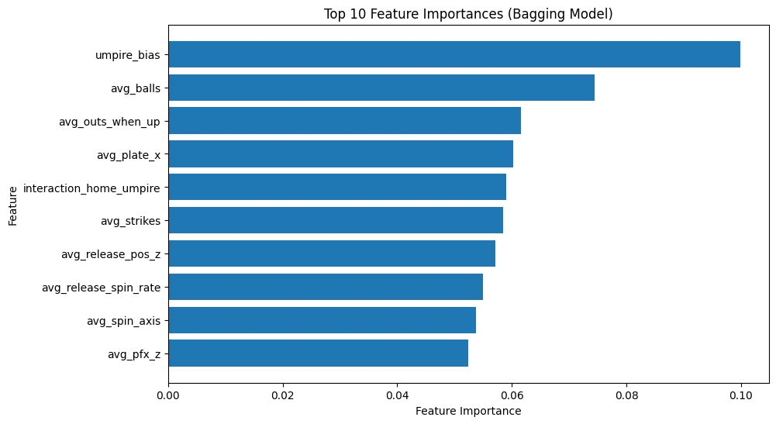
Model: Bagging
For bagging, we determine our optimal number of estimators to be 300, optimal subtree depth to be 35, and train MSE = 0.0379, test MSE = 0.3315, while our R² = 0.0525.
Training Time (with parameter grid): 5-10 min
Notes:
radvilas
Bagging aims to reduce variance and improve accuracy by averaging predictions from multiple decision trees trained on different subsets of the data.
Because of this, we expect bagging to perform well due to its ability to handle complex relationships and reduce overfitting.
We expect it to outperform the simplest models like the single decision trees, and most likely to outperform kNN, due to ensemble learning's focus on variance reduction.
Because Bagging trees are trained on different subsets of the data, more features appear in our feature importance. Umpire bias remains the most important, while avg balls, outs, and strikes when up now play a larger role, in addition to home-umpire interaction and pitch position on the plate.

Slide 11
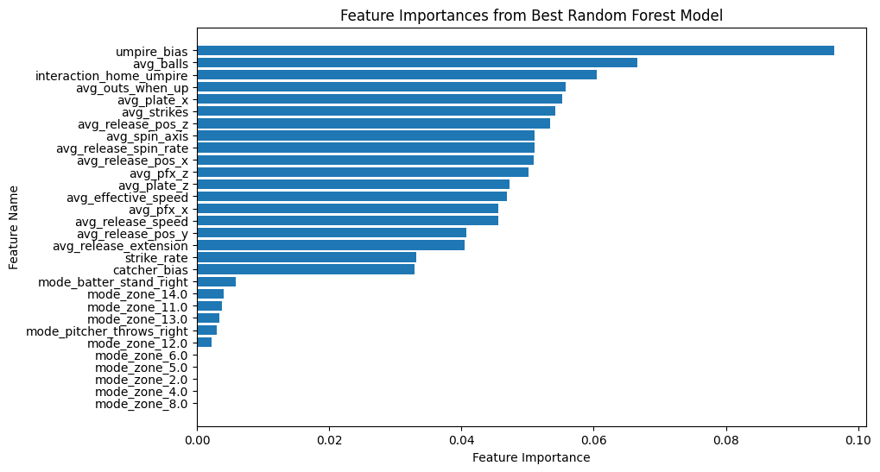
Model: Random Forest
Trying out different hyperparameters such as max_depth=[15, 20,...], n_estimators = [50, 100, 200,...], yields the most optimal parameters (MSE-wise) to be max_depth=40, n_estimators = 250, resulting in most optimal train MSE = 0.0377, test MSE = 0.3291, and R² = 0.0594.
Training Time (with parameter grid): 5-10 min
Notes:
radvilas
Random Forest further de-correlates trees compared to bagging, by randomly selecting a subset of features at each split. Beause of this, it is more robust to overfitting and better at dealing with complex relationships.
We expect its performance to be among the best, potentially even better than bagging, and certainly better than simpler models.
Because it selects a random subset of predictors for each tree, RF unsurprisingly has many important features, though umpire bias is back to the top, with avg balls, outs, and strikes, home-umpire interaction, and pitch position on the plate, remaining important as in bagging. These features keep showing up in our best models so are likely the truly most important ones.

Slide 12
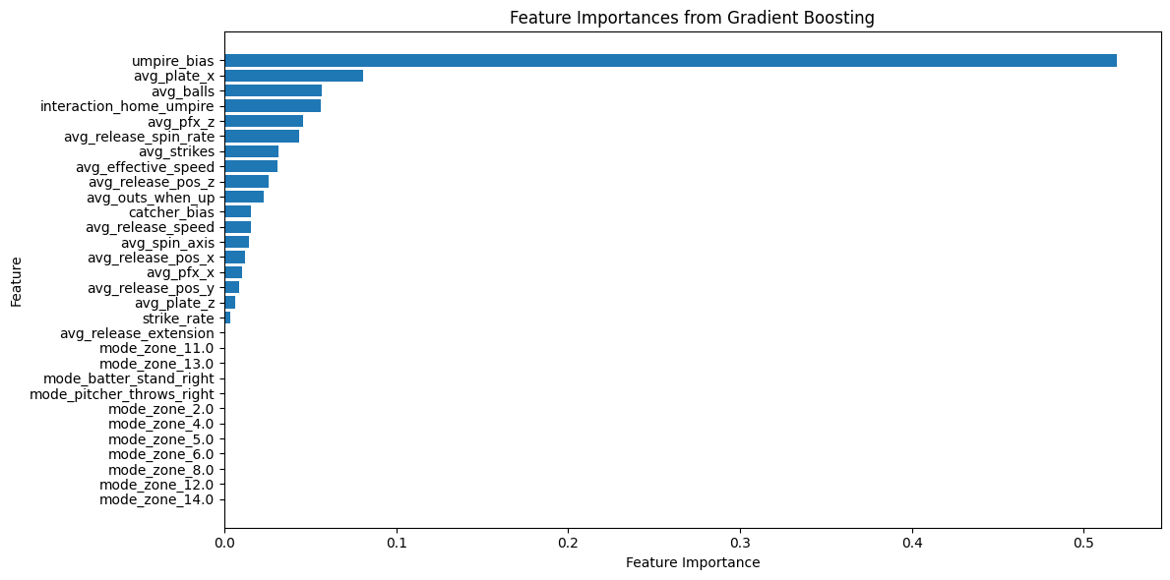
Model: Boosting
Searching for most optimal hyperparameters, we find best max_depth=2, n_estimators=550, learning_rate=0.01 which result in train_MSE=0.2687, test_MSE=0.3468,
R² = 0.0089.
Training Time (with parameter grid): > 20 min
Notes:
radvilas
Gradient Boosting will train an ensemble of trees sequentially, rather than parallel. Because of this, tuning our Boosting model took a much longer runtime (over double the times of other ensemble learning models), which we could have expected. Typically, this iterative process creates a model that is robust to overfitting and achieves strong accuracy.
We would expect boosting to be among our top models, like Bagging and RF. It's relatively weaker performance surprised us, and we will discuss this more in our conclusion/discussion.
Umpire bias is far and away the most important in boosting, followed by some other familiar features of our previous two models (avg plate x, avg balls, home-umpire interaction, etc) as well as some others that were deemed more important via boosting.

Slide 13
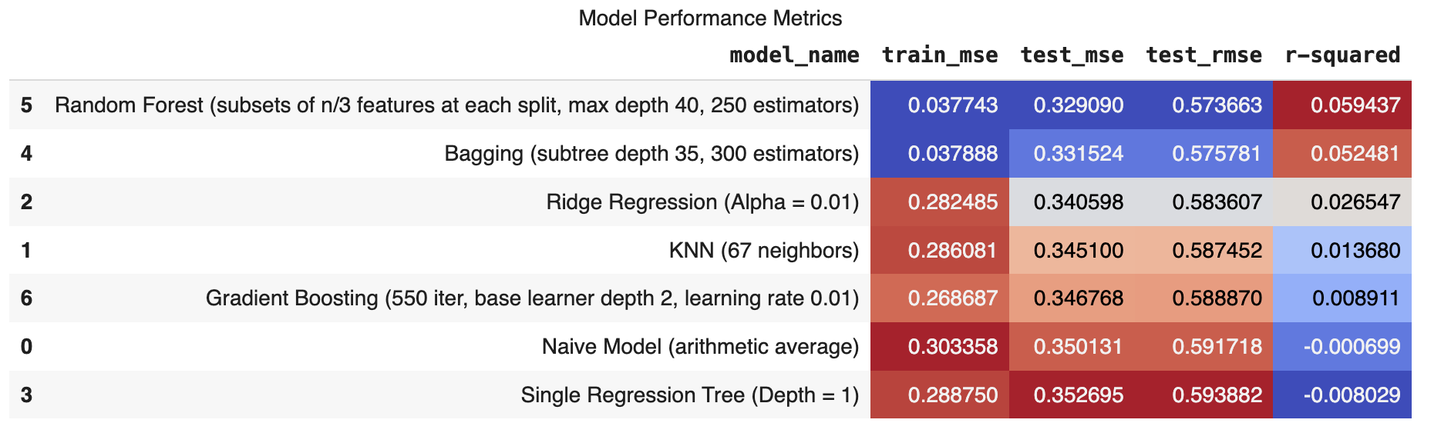
Results & Conclusion: Random Forest!
Notes:
We deem the best model is Random Forest, as it has the lowest test MSE and the highest R-Squared on unseen data.
Bagging also did well, which makes sense as ensemble learning methods should be more robust to overfitting and better at generalizing. Interestingly, Boosting underperformed expectations despite tuning the model across many parameters.
Umpire bias is the most important feature, followed by statistics such as average balls, outs, and strikes, home-umpire interaction, and pitch position on the plate. Other pitch factors such as spin, speed, and release seem to matter as well.All of these make sense as top predictors, as umpire bias and the interaction with teams or crowd pressure are likely among the biggest mental factors on an umpire's ability to make calls. Balls, outs, and strikes may sway an umpire to want to end an inning or game for a final batter, or may just add additional pressure in pitch calling which could cause inaccuracy. And pitch metrics such as release speed, spin, and position, of course make sense as these dictate how hard a pitch will be to follow to the naked eye.
RMSE even in our best models is barely below one standard deviation of the data, meaning we are not much better than the naive model. Our R squared also never exceeds 0.06, meaning over 94% of the variation in our response fav_h cannot be explained by our modeling.
Hence, it appears that much of the umpire bias effect is in fact random and not due to pitch framing or other factors. This is actually not a bad conclusion, as it is evidence that umpires are reliable despite circumstances, for the most part. Still, there may be a better model given more time and data.

Slide 14
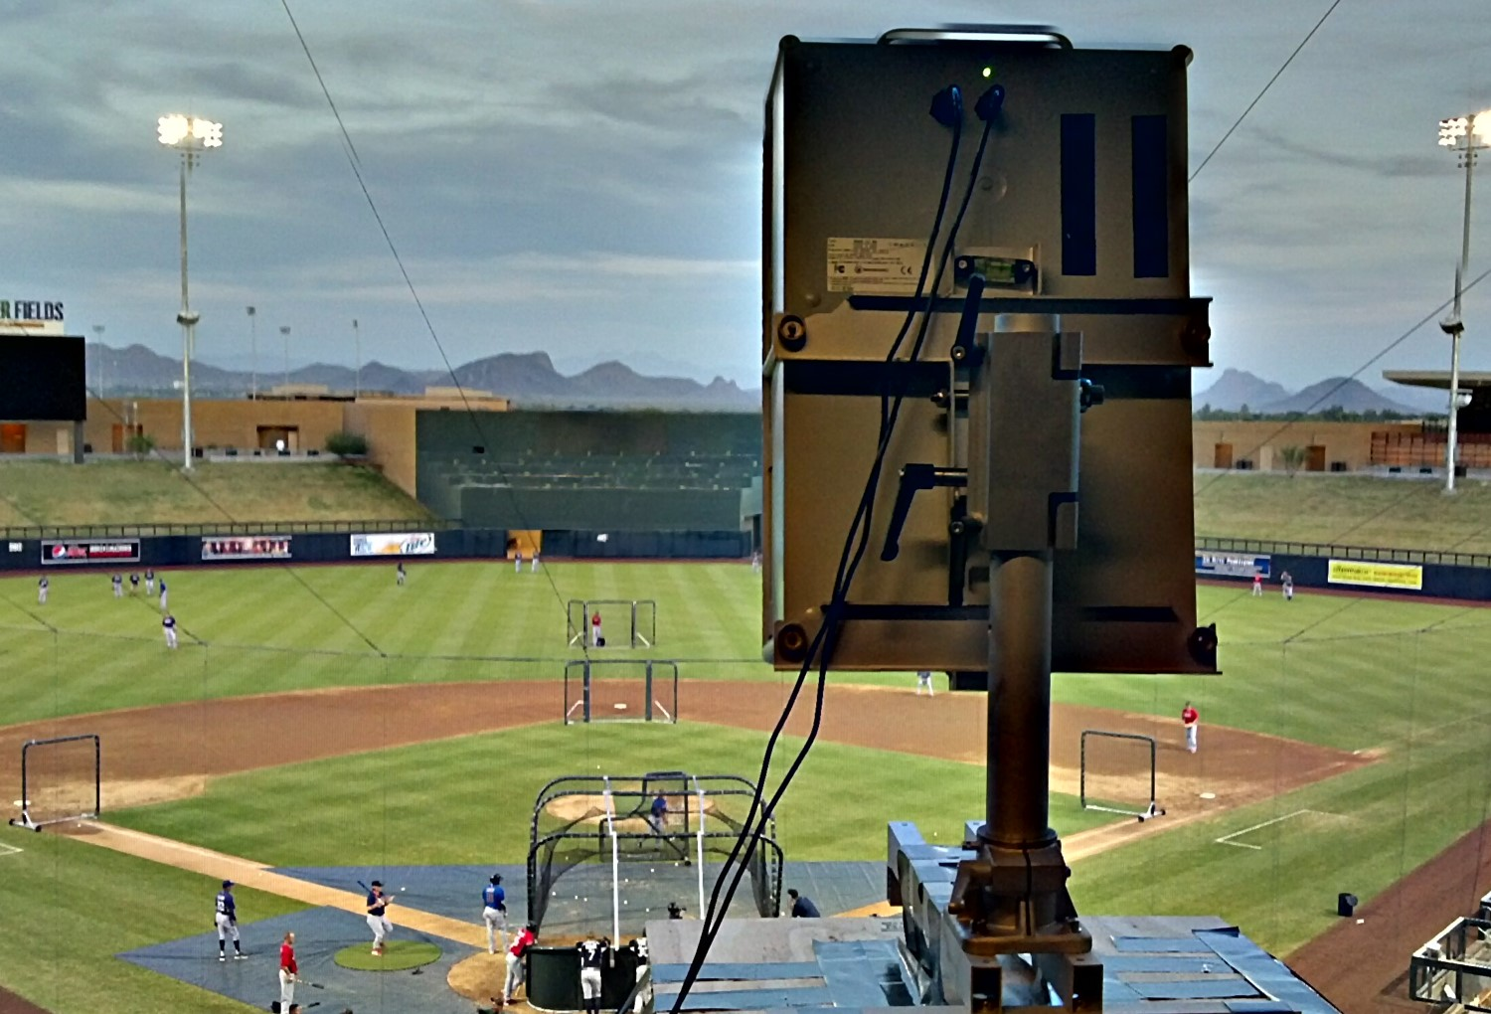
Finding predictors more indicative of bias in baseball umpiring
Weather? Different pitch data?
Learning and implementing better model types
Researching the benefits of integrating robot umps in MLB as opposed to human umps (robo-umps already exist in the minors)
Future Work
Notes:
rosh

Slide 15
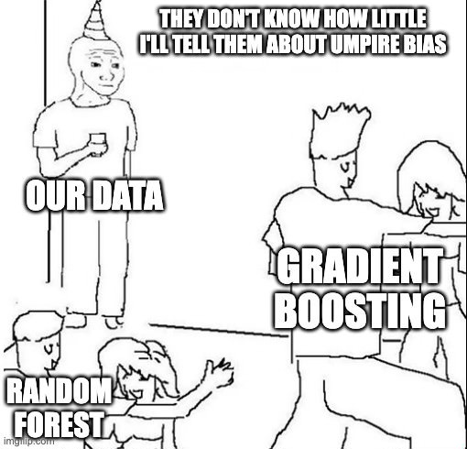
Thank you!
Notes:
rosh

